Slide 1
真实语料总汇
2A 漫画
Fumei Chiu

Slide 2
Learning Objectives
I can identify words in the pictures. (恋/恋爱）
I can infer the meanings of the unknown words.
I can infer the author’s point of view.
I can activate background knowledge.

Slide 3
Targeted Literacy Skills
Lower-Level:
I can recognize the components of character 恋.
I can handwrite 恋 in standard stroke order.
I can infer the meanings of unknown compound words.
Higher-Level:
I can activate background knowledge.
I can infer the author’s points of view.

Slide 4
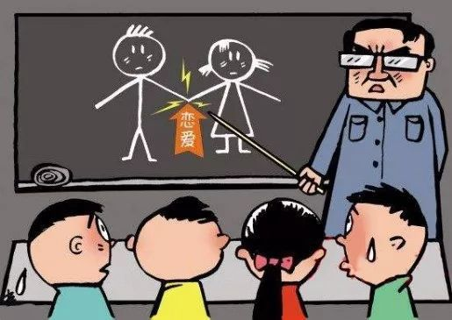
https://www.163.com/dy/article/FROJ4UVI0516W355.html
Notes:
https://www.163.com/dy/article/FROJ4UVI0516W355.html

Slide 5
恋爱
戀愛
https://language.chinadaily.com.cn/2015-10/14/content_22185281.htm
Notes:
https://language.chinadaily.com.cn/2015-10/14/content_22185281.htm

Slide 6
这个汉字怎么说？什么意思呢？
我爱你。
liàn
我恋你。
“恋” is used with other characters together, rarely used alone by itself.

Slide 7
Can Do Statement : I can recognize the structure of character.
“恋” 的结构（configuration）是哪一个呢？
上下
左右

Slide 8
Can Do Statement : I can identify the radical of the character.
“恋” 的 部首。
我们去 MDBG 看一下。
请你圈出哪一个是radical?

Slide 9
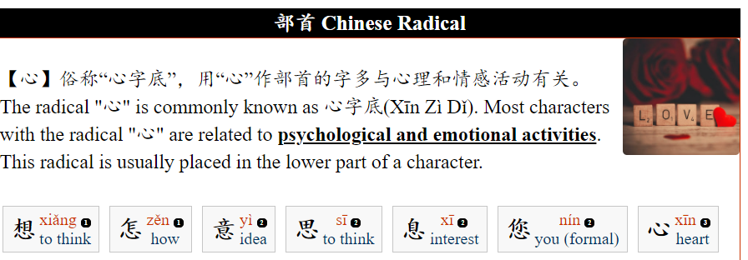
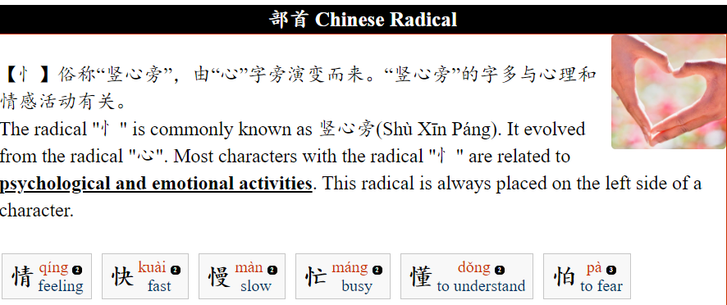
心
忄
https://www.dailyzhongwen.com/2020/05/blog-post_31.html

Slide 10
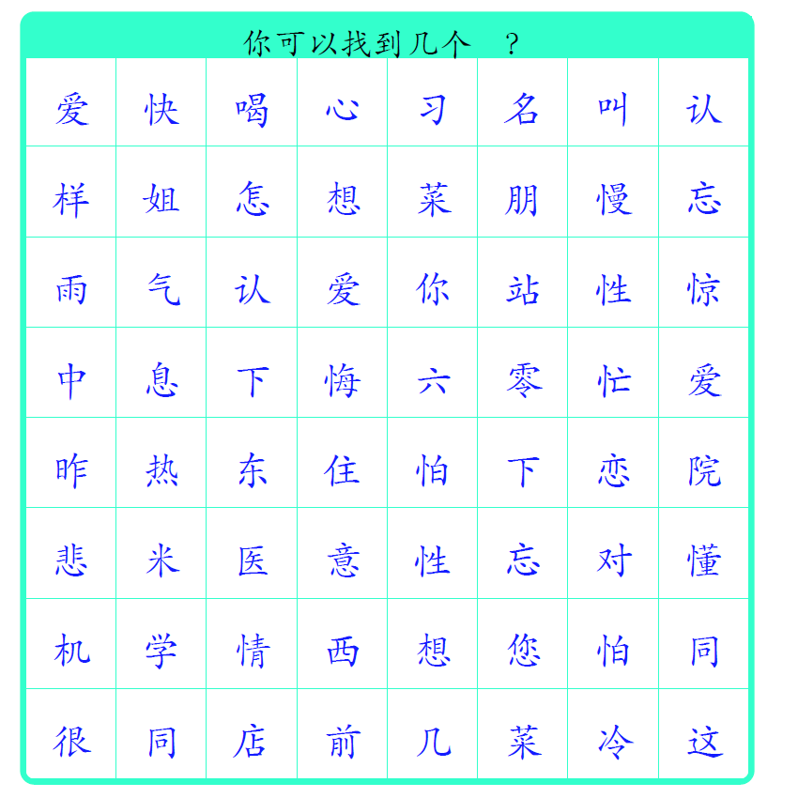
Targeted Literacy Skill : I can identify the radical of the character.
找❤！找❤！
你可以找到几个❤？

Slide 11
Targeted Literacy Skill : I can identify the radical of the character.
找❤！找❤！
你可以找到几个❤？

Slide 12
Targeted Literacy Skill : I can hand write in standard stroke order
“恋” 怎么写呢？你可以 number the stroke order 吗？
https://www.hanzi5.com/bishun/604b.html

Slide 13
Targeted Literacy Skill : I can hand write in standard stroke order
请你写第___划（___stroke ）。你写对了吗？

Slide 14
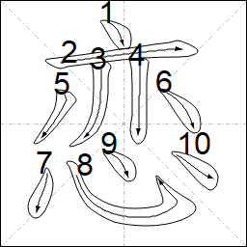
Targeted Literacy Skill : I can hand write in standard stroke order
请你写第___划（___stroke ）。你写对了吗？

Slide 15
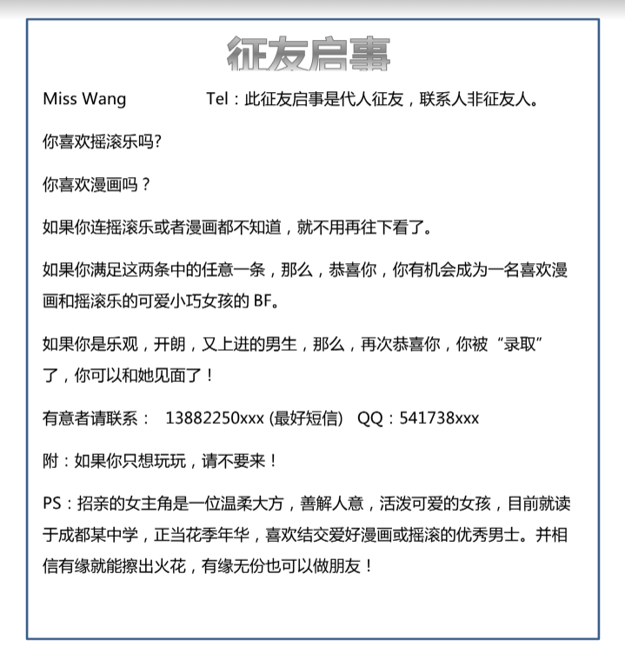
你看见什么？
“征友启事”是做什么的？
找朋友的，找男朋友或是女朋友的
为什么会有这张“征友启事”？

Slide 16
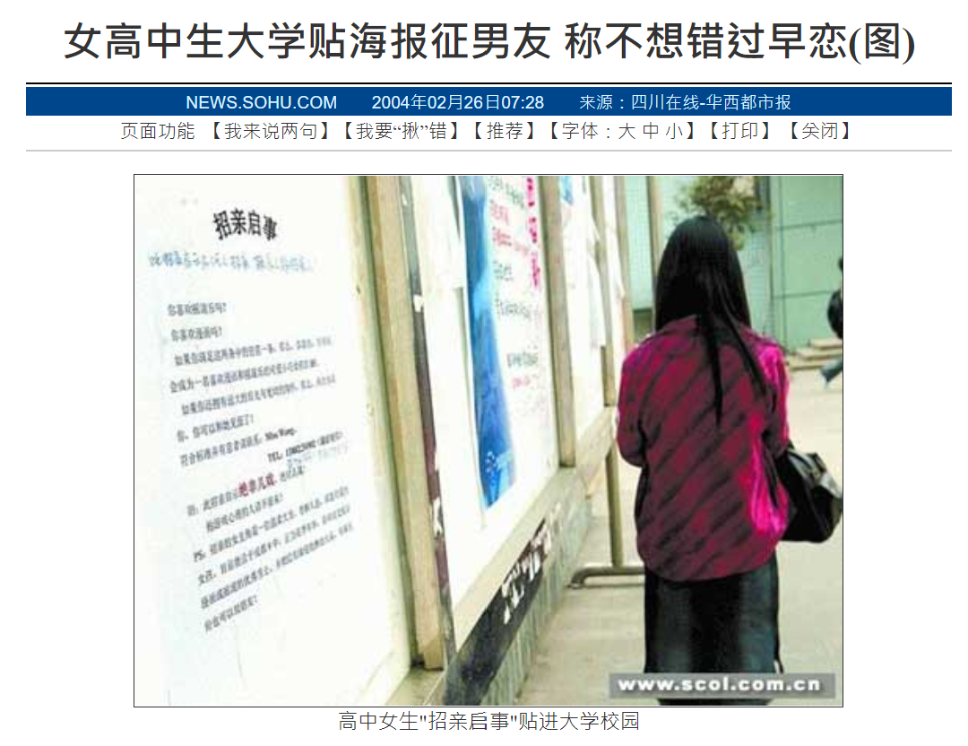
Targeted Literacy Skill : I can infer the meanings of compound words.
为什么？
不想错过“早恋”
想要“早恋”
http://news.sohu.com/2004/02/26/81/news219208189.shtml

Slide 17
Can Do Statement : I can infer the meanings of compound words.
早 + 恋 = 早恋
https://kknews.cc/zh-cn/essay/q5erroy.html
https://language.chinadaily.com.cn/2015-10/14/content_22185281.htm

Slide 18
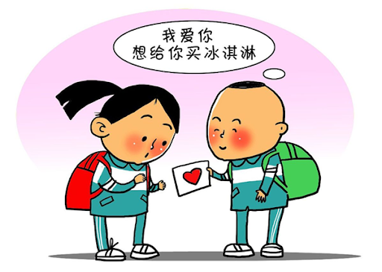
早恋就是小学生或是中学生谈恋爱。
很多爸爸妈妈不喜欢小孩在小学或是中学的时候谈恋爱，因为他们觉得太早谈恋爱了，所以他们不喜欢小孩早恋。
http://www.zhzljy.com/puppylove/20200707/591.html

Slide 19
Targeted Literacy Skill : I can infer the meanings of compound words.
早恋
黄昏恋
小学生
中学生
谁？
http://www.zhzljy.com/puppylove/20200707/591.html

Slide 20
Targeted Literacy Skill : I can infer the meanings of compound word (黄昏）.
早上太阳出来了，喝一杯咖啡。
黄昏太阳下去了，我们一起看漂亮的天空。
https://m.36992.com/tupian/59247.html
https://699pic.com/tupian-500617398.html

Slide 21
Targeted Literacy Skill : I can infer the meanings of compound words.
黄昏 + 恋 = 黄昏恋
https://language.chinadaily.com.cn/2015-10/14/content_22185281.htm
https://bbs.wenxuecity.com/ktv/1924262.html

Slide 22
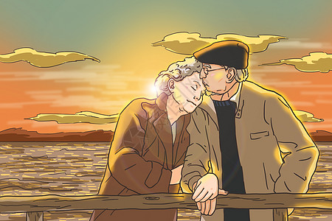
黄昏恋是老人交男女朋友，老人谈恋爱。
https://img95.699pic.com/photo/40027/8625.jpg_wh300.jpg

Slide 23
Targeted Literacy Skill: I can infer the meanings of compound words.
你认为这些字是什么意思呢？什么样子的恋爱呢？
小学生、中学生谈恋爱 老人谈恋爱 上网谈恋爱 第一次谈恋爱 三个人谈恋爱 男跟男谈恋爱，女跟女谈恋爱 非常喜欢自己 我喜欢TA，可是TA不喜欢我。 我喜欢TA，可是他不知道我喜欢TA。 谈恋爱谈得很火热
Form new words to fill in the blanks
Select the appropriate words from the list to describe new words
早 + 恋 = 早恋 = __________ 黄昏 + 恋 = 黄昏恋 = __________ 初 + 恋 = __________ = __________ 热 + 恋 = __________ = __________ 网 + 恋 = __________ = __________ 自 + 恋 = __________ = __________ 单 + 恋 = __________ = __________ 暗 + 恋 = __________ = __________ 三角 + 恋 = __________ = __________ 同性 + 恋 = __________ = __________
A
D

Slide 24
Targeted Literacy Skill: I can infer the meanings of compound words.
早恋
puppy love
romantic relationship sparked between elderly couple
黄昏恋
早
黄昏
初
三角
热
恋
同性
自
网
单
暗

Slide 25
Targeted Literacy Skill : I can use lexical inference to form new compound words.
现在，换你了。 请你从生词单里找一个汉字，组四个词。帮每一个新词找一张图或是画一张图。

Slide 26
Targeted Literacy Skill : I can use lexical inference to form new compound words.
现在，换你了。 请你从生词单里找一个汉字，组四个词。 ( Select one character from the vocabulary list to form new words)
网恋
自恋
恋
https://www.jiandanxinli.com/materials/1442?utm_source=position&utm_medium=knowledge-1
https://www.52lishi.com/article/63275.html
同性恋
三角恋
https://zhuanlan.zhihu.com/p/370442681
https://kknews.cc/zh-sg/emotion/v8ekav4.html
Notes:
https://thumbs.dreamstime.com/b/imprimir-194118931.jpg

Slide 27
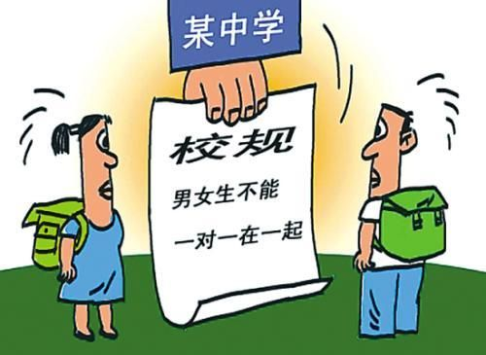
Targeted Literacy Skill : I can infer the author’s point of view.
如果你是学校的中文报纸的记者，你的编辑给了你这张图片，请你给这张图片一个标题，你会给什么？
Type Your Caption Here.
If you were a reporter for your school’s newspaper and your editor gave you this picture and asked you to give him a caption, what would you give?
男女生不可以谈恋爱！
学生不可以早恋！
http://zj.sina.com.cn/news/social/12/2012/0410/35215.html
Notes:
http://zj.sina.com.cn/news/social/12/2012/0410/35215.html

Slide 28
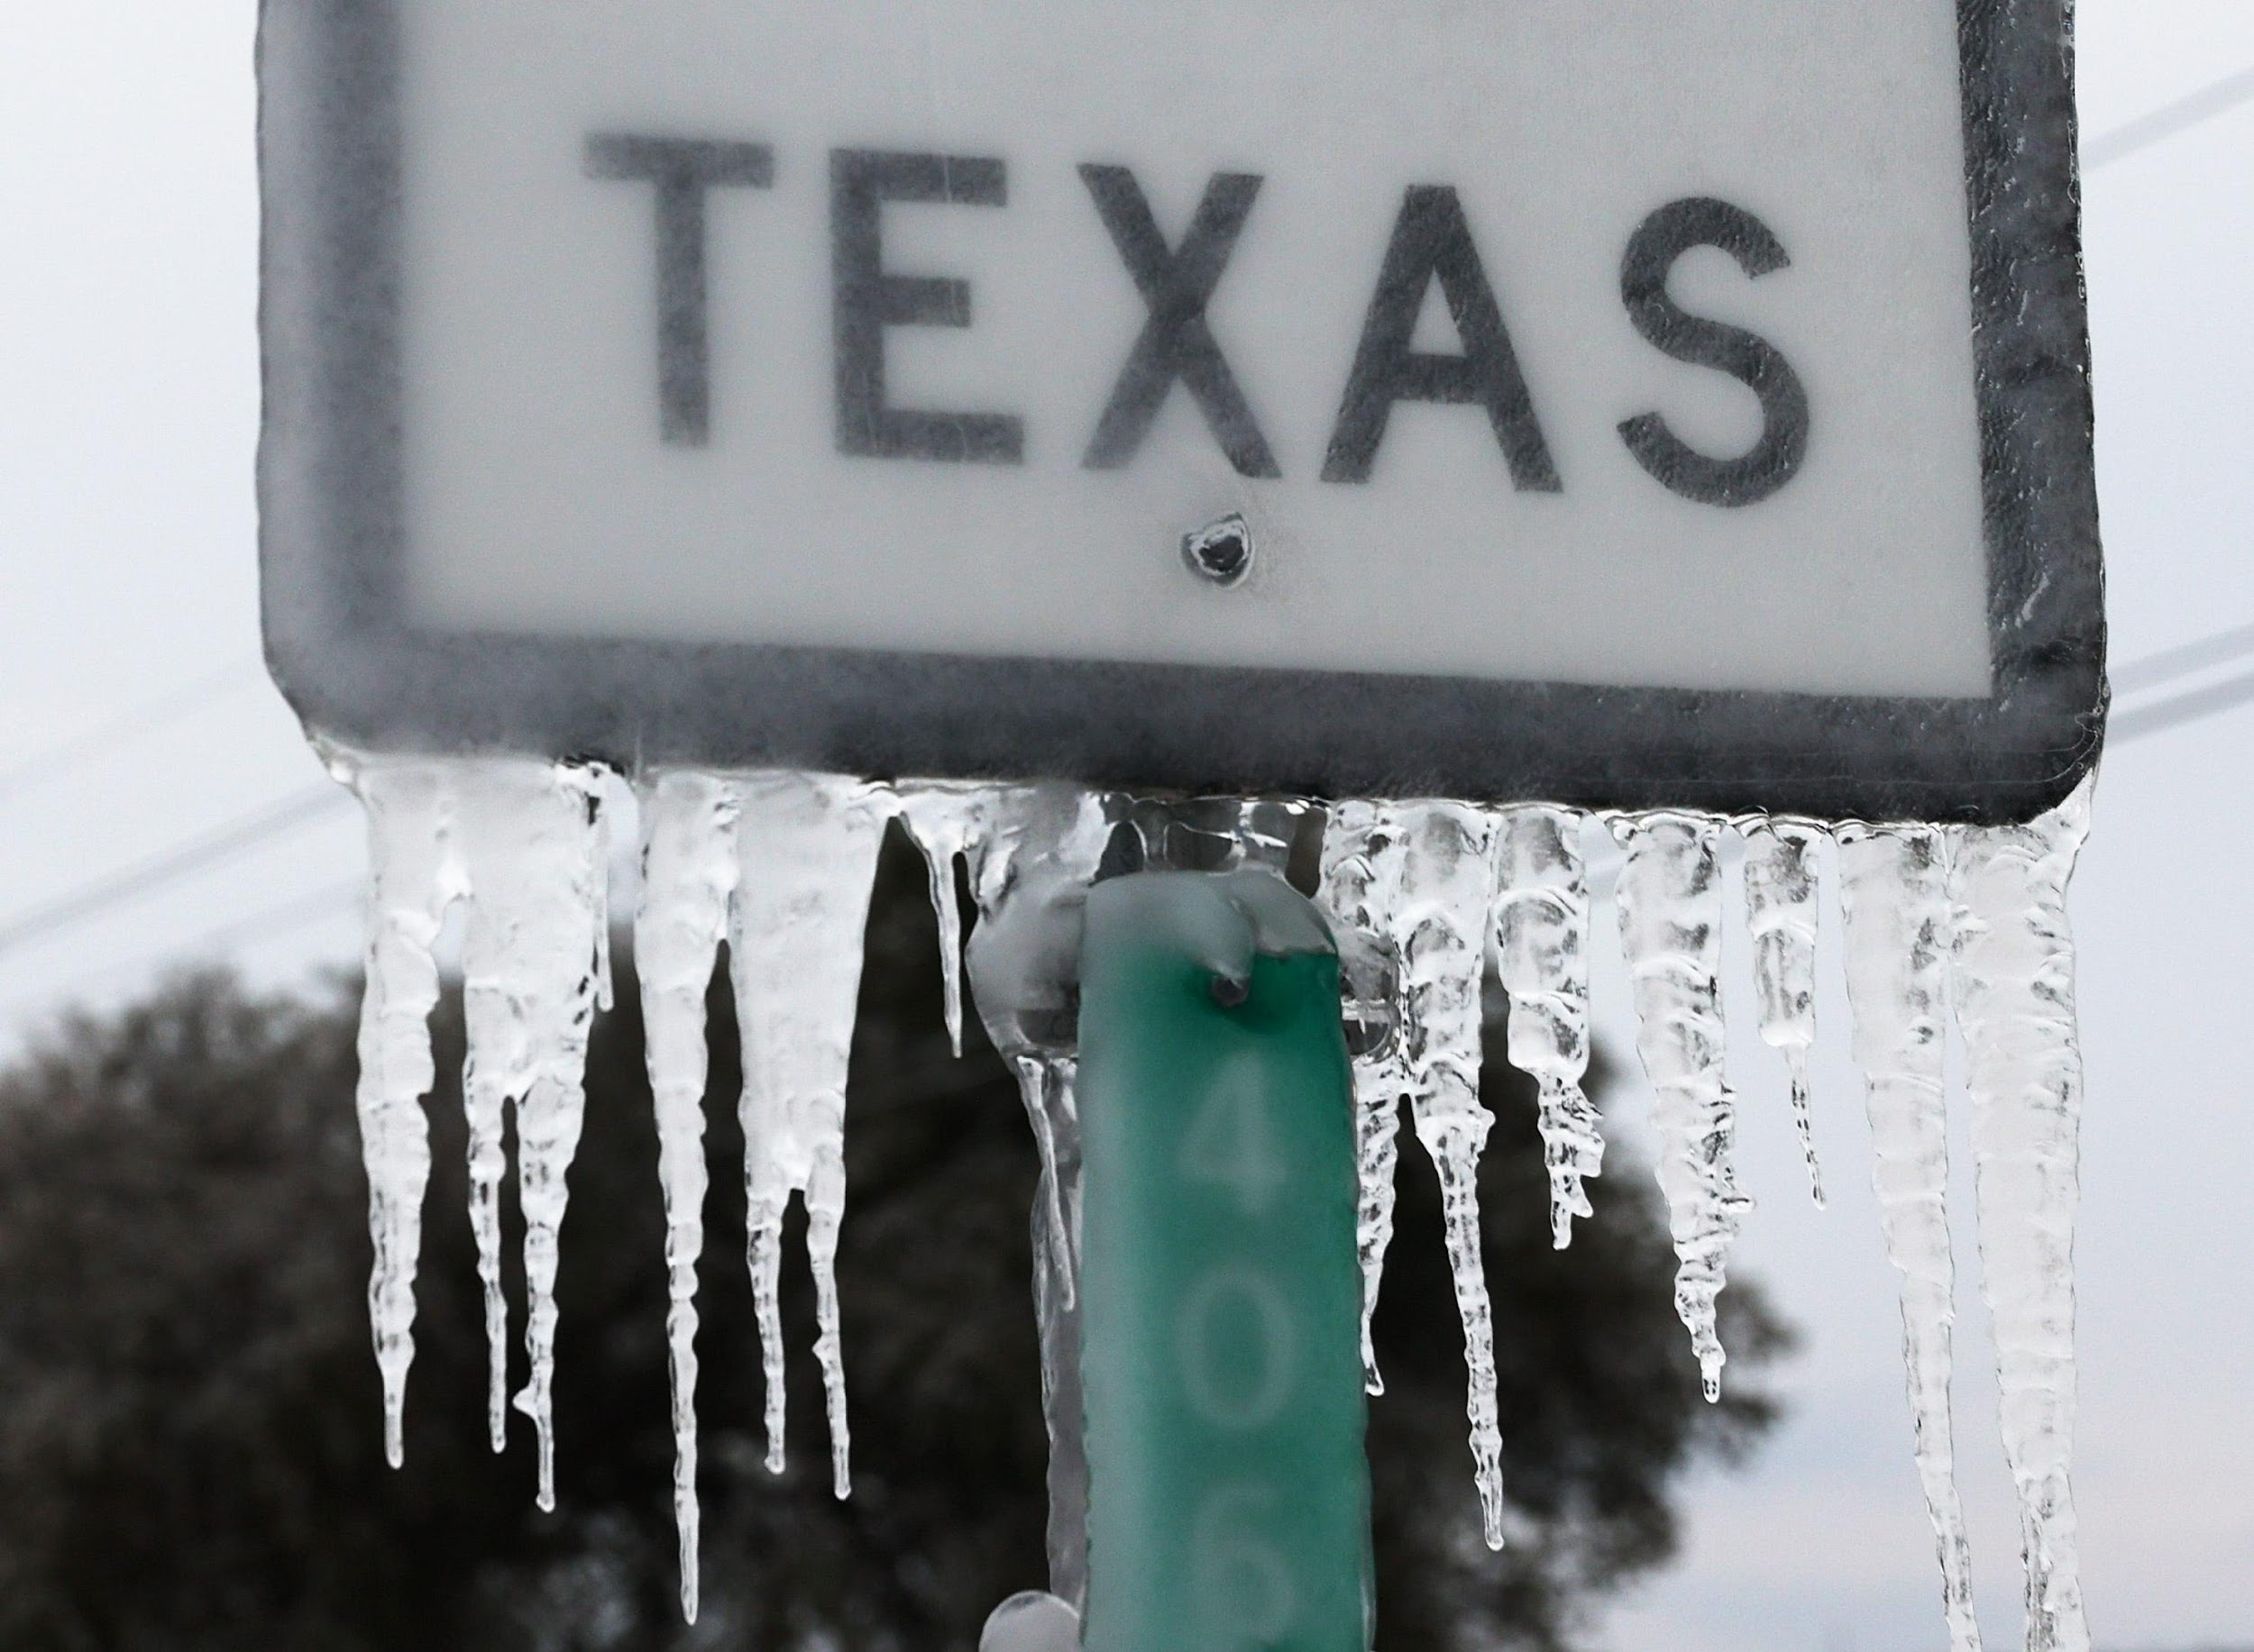
2021年二月
正常
不正常
https://www.gannett-cdn.com/presto/2021/02/24/USAT/21397b3d-8d34-4c4d-b567-1da24b0608e2-GTY_1302856902.jpg

Slide 29
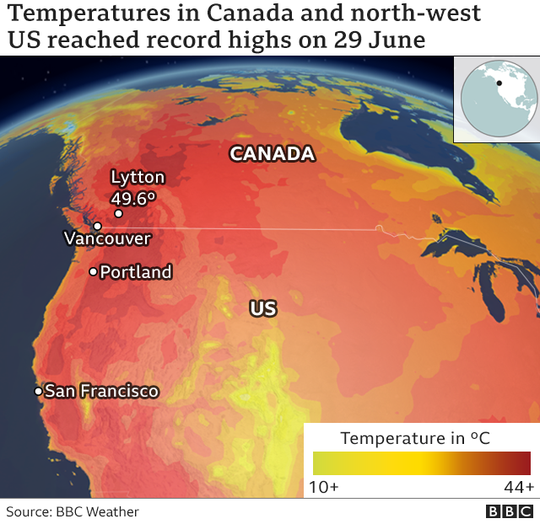
2021年六月
正常
不正常
https://ichef.bbci.co.uk/news/640/cpsprodpb/148B1/production/_119154148_canada_heatwave_640-nc.png

Slide 30
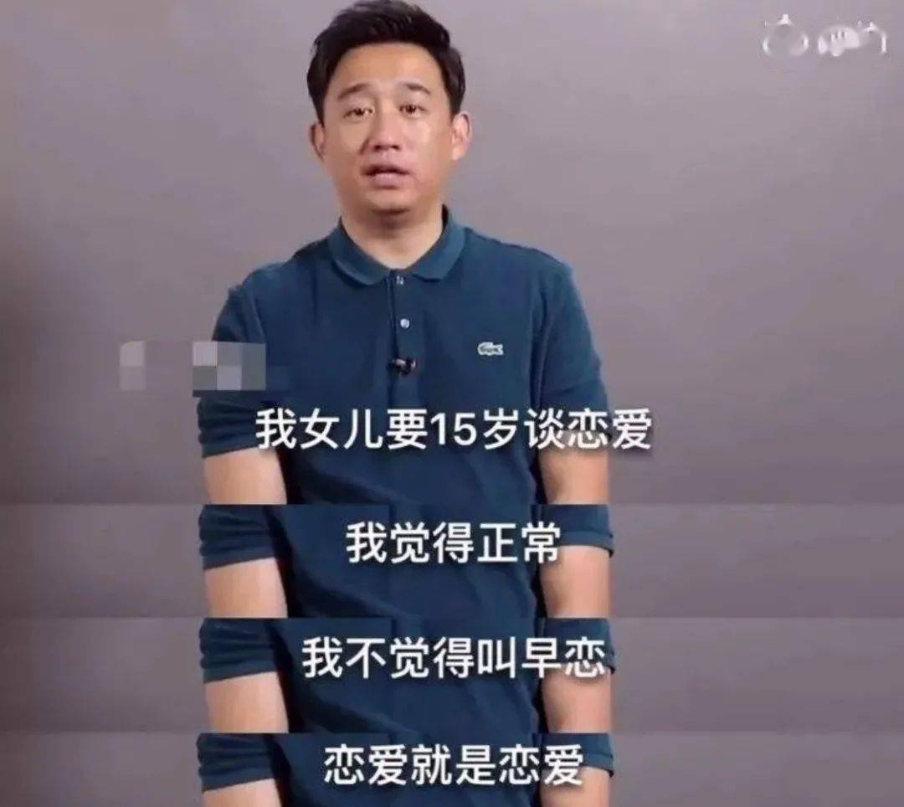
常常/日常
正 + 常 = 正常
英文是什么意思？
normal
http://www.bornuo.com/m/view.php?aid=25966
Notes:
http://www.bornuo.com/m/view.php?aid=25966

Slide 31
Targeted Literacy Skill: I can identify the author’s point of view.
Circle the words “ 恋爱”in the picture.
2.如果这位爸爸的女儿15岁要谈恋爱，她可以吗？
可以
不可以
3. Underline your evidence in the picture that support your response to the second question.
http://www.bornuo.com/m/view.php?aid=25966
Notes:
http://www.bornuo.com/m/view.php?aid=25966

Slide 32
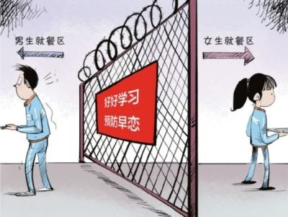
Targeted Literacy Skill : I can infer the author’s point of view.
谁？
喜欢不喜欢？
在哪儿？
为什么？
做什么？
http://gd.sina.com.cn/fs/education/2016-01-29/city-fs-ifxnzanh0314461.shtml

Slide 33
Targeted Literacy Skill : I can infer the author’s point of view.
好好学习
预防早恋
图里的标识（sign）,你认为学校是希望学生怎么样？
要谈恋爱
不要谈恋爱
“预防”的英文意思，你认为是哪一个？
Prevent
Encourage
http://gd.sina.com.cn/fs/education/2016-01-29/city-fs-ifxnzanh0314461.shtml

Slide 34
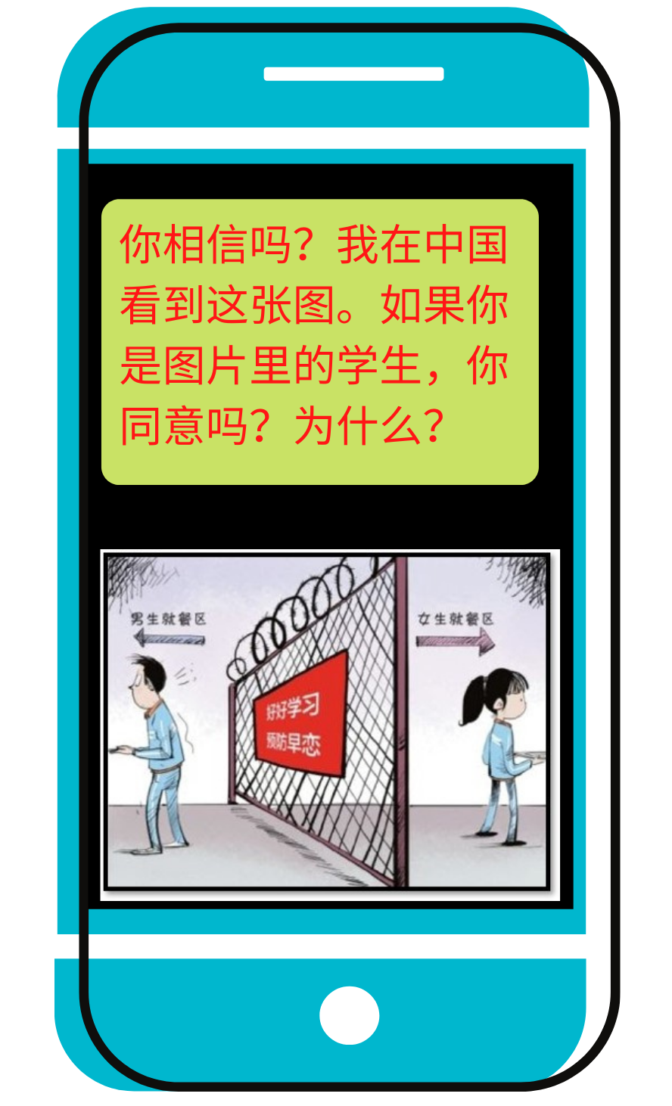
Targeted Literacy Skill : I can infer the author’s point of view.
王大中给小美的短信
小美给王大中的短信
Wang Dazhong saw this picture in China and sent a text message to his friend Xiaomei in the US. Do you agree with the message the picture is to convey? Why? If you were Xiao Mei, how would you reply to Wang Dazhong’s message? You may use words from the picture in your response.
Type your response here.
我不同意。如果我是她，我就不可以跟我的男朋友一起吃饭了。再说，男生跟女生不在一起吃饭，还是可以谈恋爱。
Made ( template) by Canva.
Picture resource： http://gd.sina.com.cn/fs/education/2016-01-29/city-fs-ifxnzanh0314461.shtml

Slide 35
Targeted Literacy Skill : build automaticity
Short text read aloud (小美回王大中的短信)
这是真的吗？太糟糕了。男生跟女生不可以在学校一起吃饭。如果我是图片里的女生，我不同意这个办法。学校认为男生跟女生一起吃饭就是谈恋爱吗？可是男生跟女生在一起吃饭很正常，高中生谈恋爱也很正常。我非常不喜欢这个办法。如果我是那个女生，我会天天哭，不想上学。
http://gd.sina.com.cn/fs/education/2016-01-29/city-fs-ifxnzanh0314461.shtml
Read Aloud : reading automaticity

Slide 36
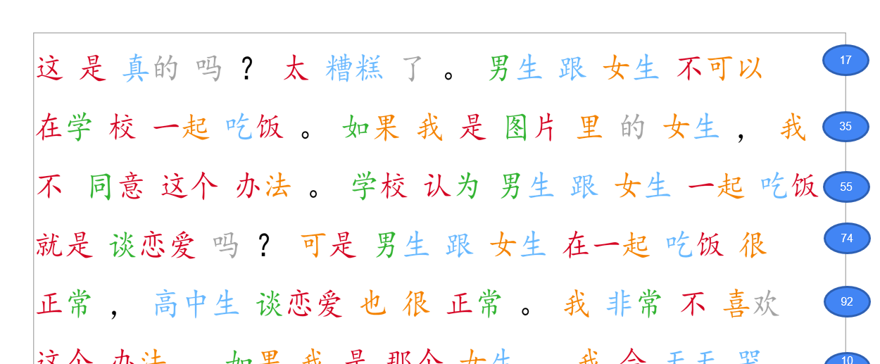
Timed Repeated Reading Aloud (小美回王大中的短信)
Targeted Literacy Skill : build automaticity
pair work
 | A ( Reader) | B ( Listener)
1 | Reading the article without pinyin in one minute Say “ 啊” for each unknown character, and continue reading | Set the timer for one minute Refer to the answer key ( the article with pinyin) Listen to A’s reading Highlight or circle any mispronounced character(s) on the answer key Count the number of characters A read Record the finishing time if A finishes the article in less than one minute
建议一篇文章至少让学生朗读两次。

Slide 37
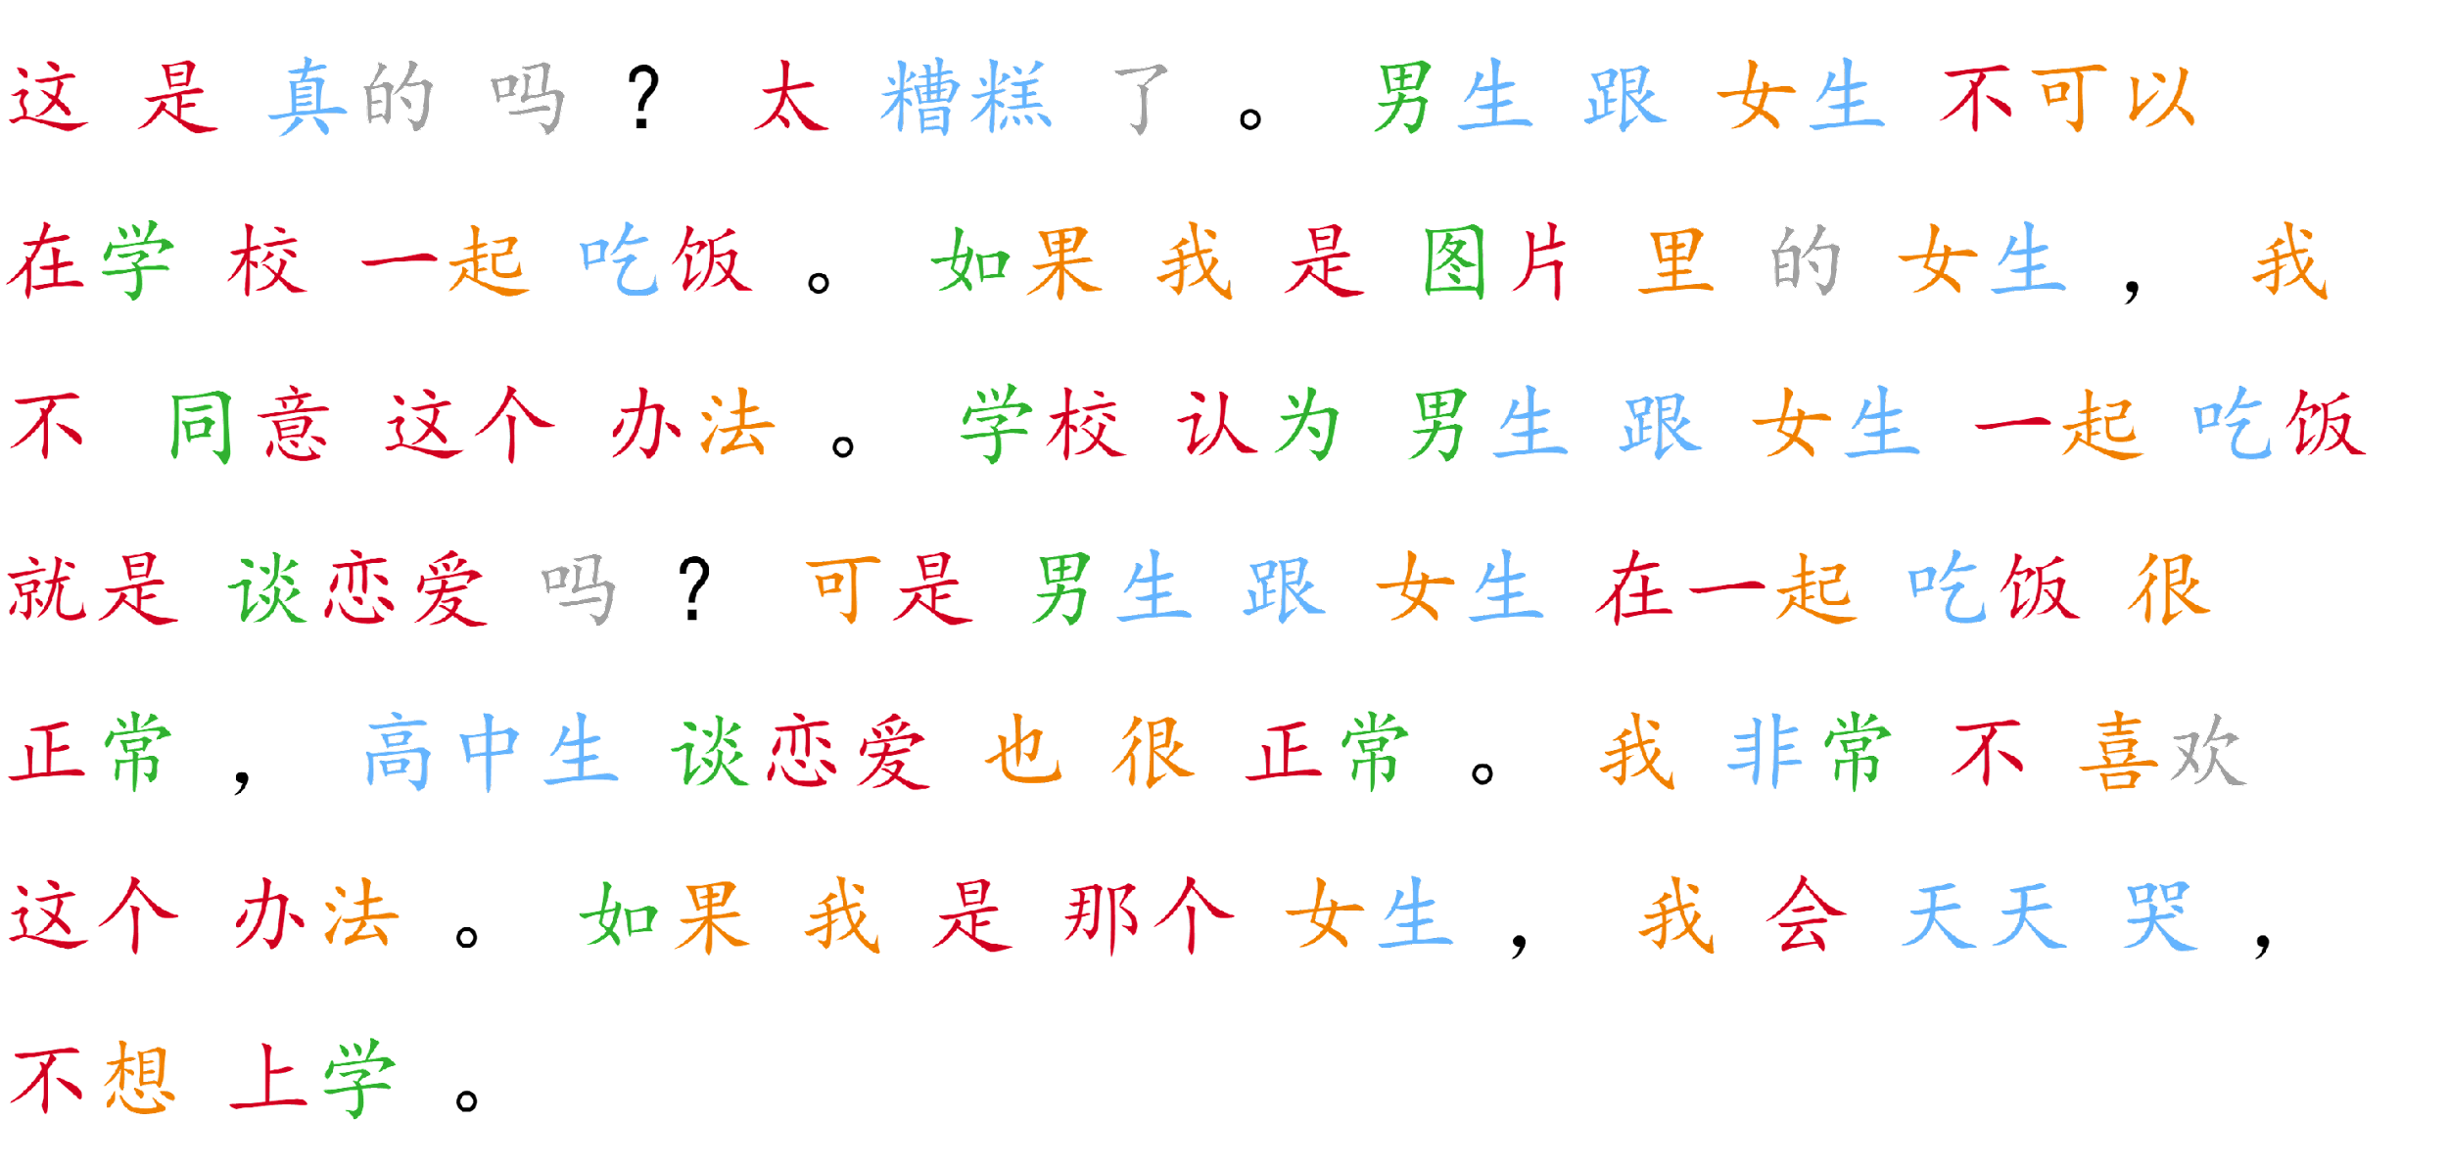
Timed Repeated Reading Aloud Text
17
35
55
74
92
109
113

Slide 38
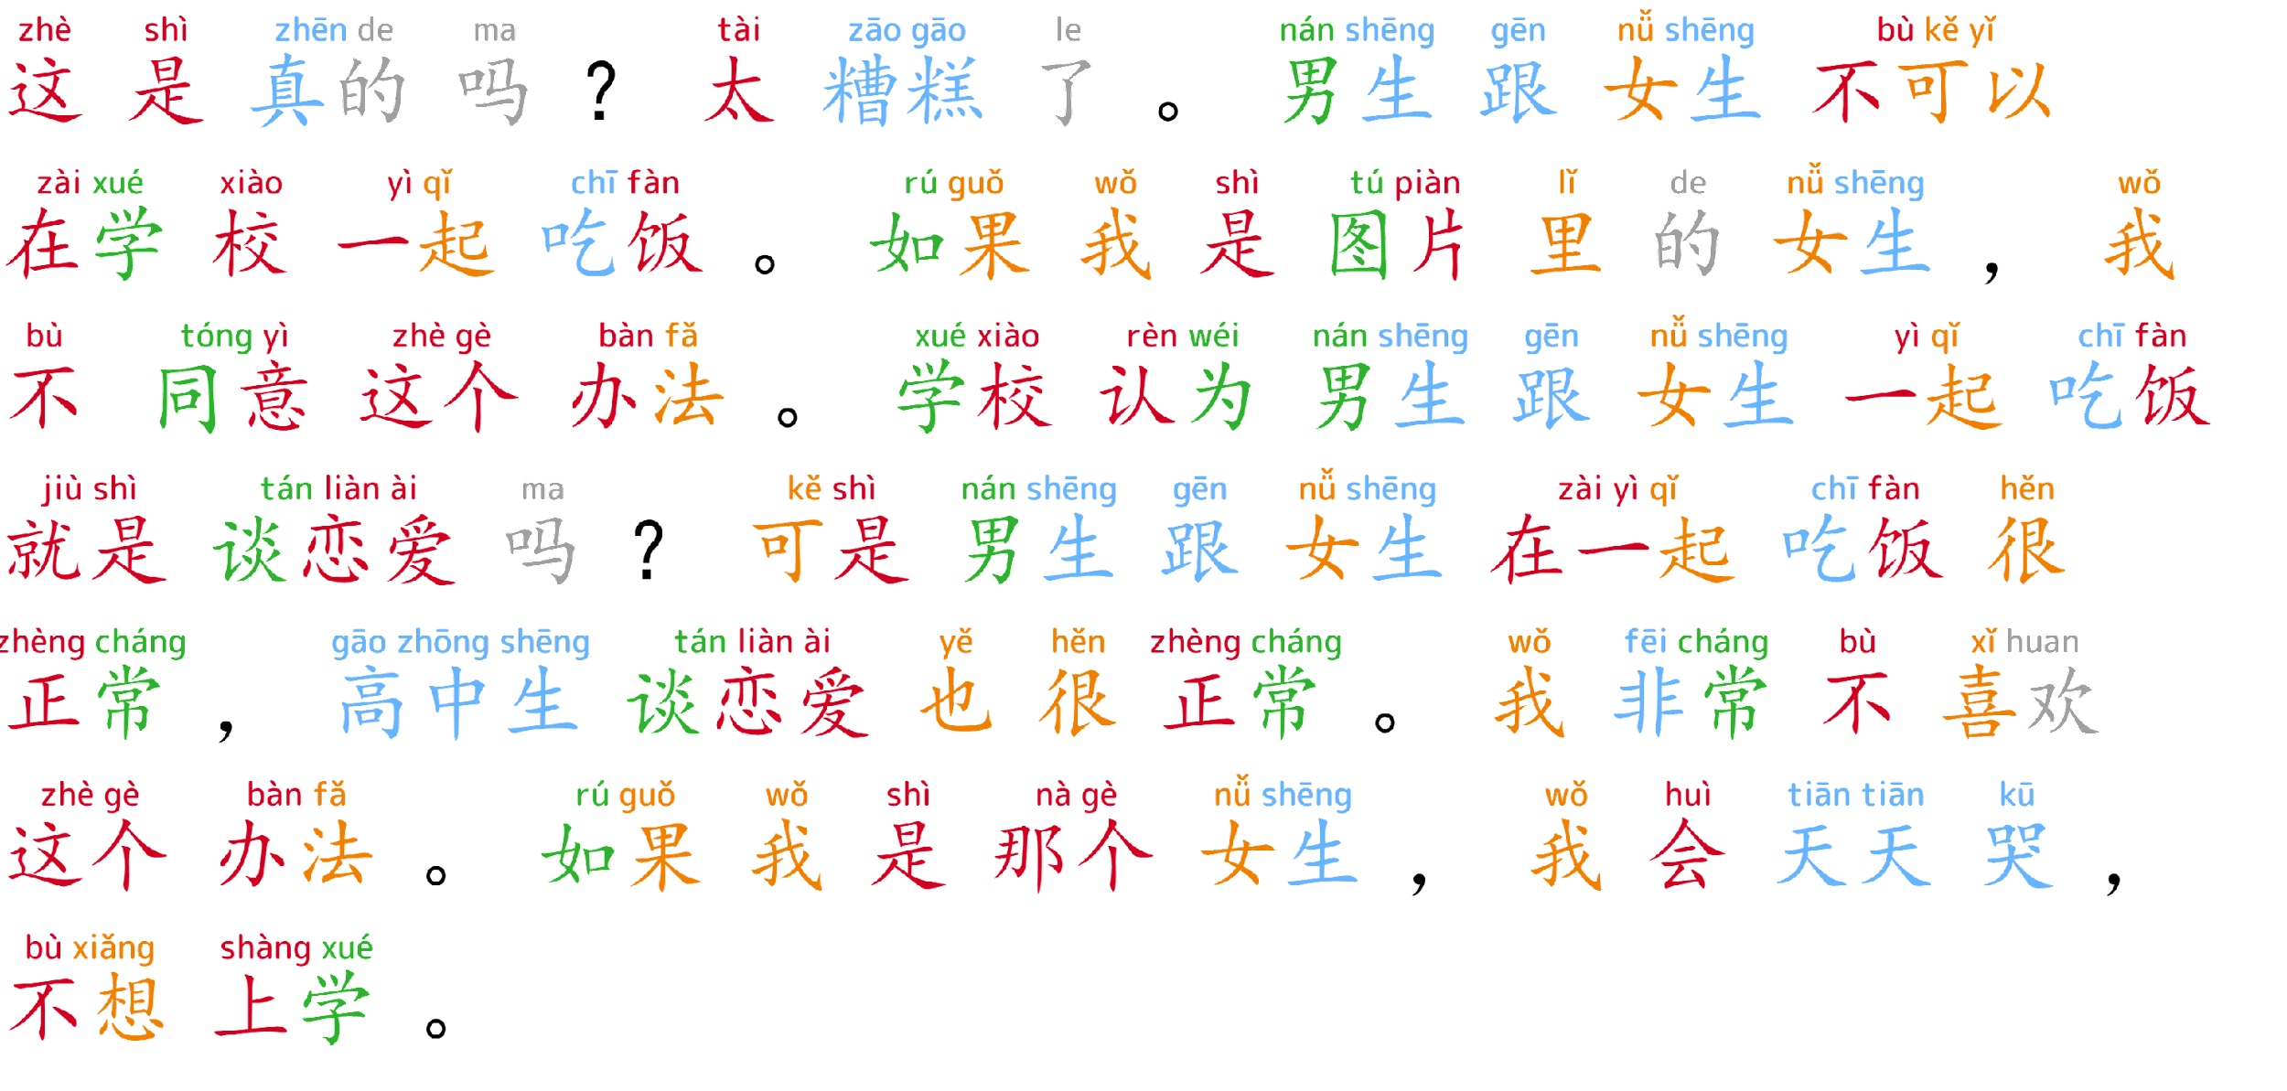
Timed Repeated Reading Aloud Answer Key ( Highlight/Circle any mispronounced characters )
17
35
55
74
Work directly on Peardeck, Nearpod, Jamboard .. any online whiteboard
Use paper: give each student a copy of this, use different colors of pens to circle on the handout
92
109
113

Slide 39
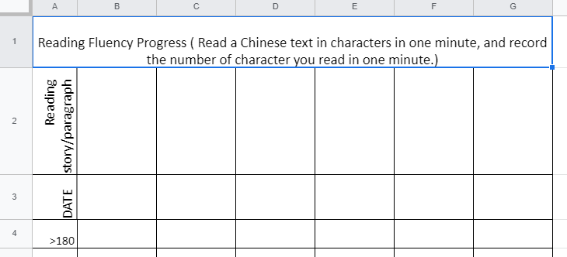
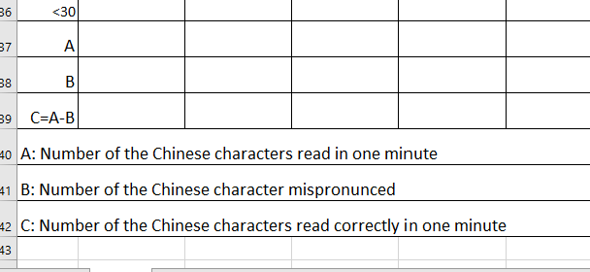
Short text read aloud (小美回王大中的短信)
Targeted Literacy Skill : build automaticity
pair work
 | A ( Reader) | B ( Listener)
2 | Fill out the timed repeated log ( google sheet) based on B’s feedback | Provide feedback to A ( numbers of character read, characters mispronounced.)
Type the number from B, the listener.
Type the title of the article and date on top of the log

Slide 40
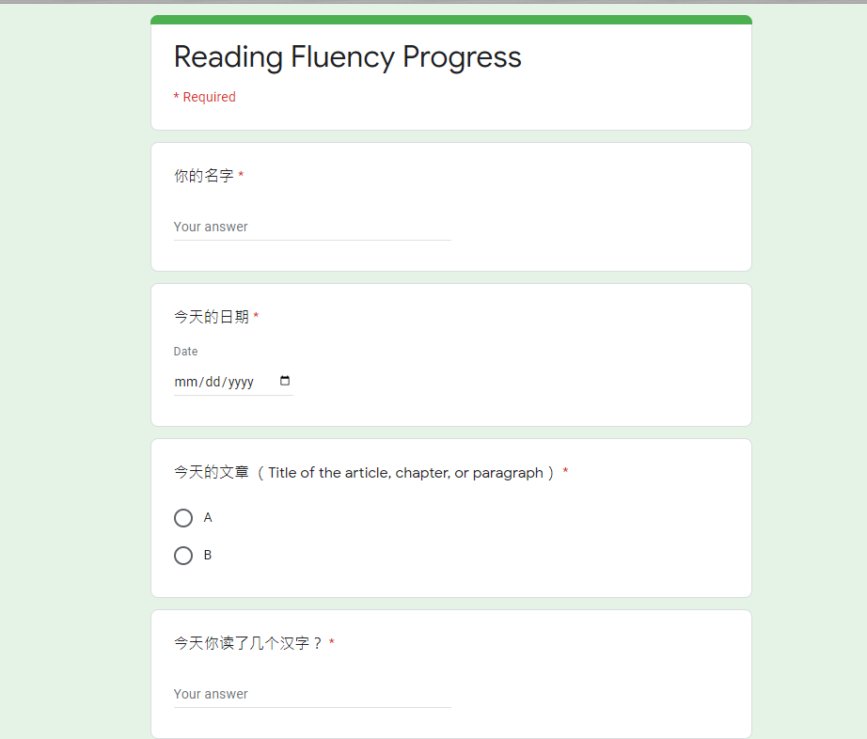
Timed Repeated Reading Aloud (小美回王大中的短信)
Targeted Literacy Skill : build automaticity
pair work
 | A ( Reader) | B ( Listener)
3 | Switch Role and repeat the process ( B will be the reader, and A will be the listener.)
4 | Fill out the data collection ( google form) for the teacher to collect the data from the whole class
Suggestion: Modify the form for your need.

Slide 41
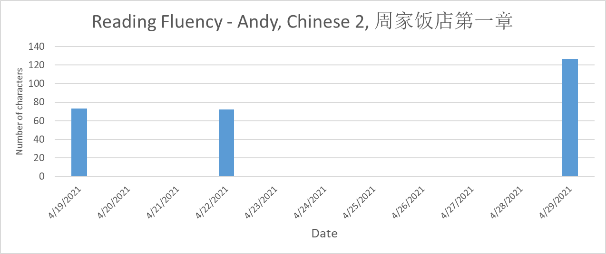
Timed Repeated Reading Aloud
每一个学生要
Read aloud to a partner
Listen to a partner’s reading aloud
Fill out the log ( google spreadsheet)
Fill out the data collection form for the teacher to collect data from the whole class ( google form)
Make a bar graph using his/her own log

Slide 42
Timed Repeated Reading Aloud (小美回王大中的短信)
pair work
 | A ( Reader) | B ( Listener)
1 | Set the timer for one minute Reading the article without pinyin in one minute Say “ 啊” for each unknown character, and continue reading | Refer to the answer key ( the article with pinyin) Listen to A’s reading Highlight or circle any mispronounced characters on the answer key Count the number of character A read Record the time that A reads if A finishes the article in less than one minute
2 | Fill out the timed repeated log ( google sheet) based on B’s feedback | Provide feedback to A ( numbers of character read, characters mispronounced.)
3 | Switch Role and repeat the process ( B will be the reader, and A will be the listener.)
4 | Fill out the data collection ( google form) for the teacher to collect the data from the whole class
一篇文章至少让学生朗读两次。

